Slide 1
Stem Cell differentiation

Slide 2
Differentiation
Differentiation is the process of becoming specialized stem cells from unspecialized cells.
The signals inside and outside cells that trigger stem cell differentiation.
The internal signals are controlled by a cell's genes.
The external signals include chemicals secreted by other cells, physical contact with neighboring cells in the microenvironment.

Slide 4
The process of cell differentiation starts with the fertilization of the female egg.
As soon as the egg is fertilized, cell multiplication is initiated resulting in the formation of a sphere of cells known as the blastocyst.
It is this sphere of cells that attach to the uterine wall and continues to differentiate.
As the blastocyst differentiates, it divides and specializes to form a zygote that attaches to the womb for nutrients.
As it continues to multiply and increase in size, the differentiation process results in the formation of different organs.
During the final phase of cell differentiation, there is formation of several types of differentiated cells from one of the precursor or a progenitor cell.

Slide 5
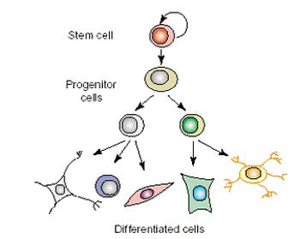
Progenitor cell
A progenitor cell is a biological cell that has a tendency to differentiate into a specific type of cell and is pushed to differentiate into its "target" cell.
The most important difference between stem cells and progenitor cells is that stem cells can replicate indefinitely, whereas progenitor cells can divide only a limited number of times.

Slide 7
blood stem cell
differentiation
only specialized types of blood cell:
red blood cells, white blood cells, platelets
Notes:
Tissue stem cells: What they can do
Tissue stem cells can often make several kinds of specialized cell, but they are more limited than embryonic stem cells. Tissue stem cells can ONLY make the kinds of cell found in the tissue they belong to. So, blood stem cells can only make the different kinds of cell found in the blood. Brain stem cells can only make different types of brain cell. Muscle stem cells can only make muscle cells. And so forth.
Scientists say that tissue stem cells are multipotent because they can make multiple types of specialized cell, but NOT all the kinds of cell in your body.

Slide 8
Distinguishing Features of Progenitor Cells and Stem Cells.
Stem cells
A progenitor cell
A stem cell is an unspecialized cell that develops into a variety of specialized cell types.
A stem cell divides and gives rise to one additional stem cell and a specialized cell.
Example: a hematopoietic stem cell produce a second generation stem cell and a RBC.
A progenitor cell is unspecialized that is capable of undergoing cell division and yielding two specialized cells.
Example: a progenitor cell undergoing cell division to yield two specialized cells (a neutrophil and a red blood cell).

Slide 9
Adult stem cells may exhibit two types of differentiation pathways;
Normal differentiation; to form specialized cell types of the tissue in which they reside.
Transdifferentiation or plasticity; cells may also exhibit the ability to form specialized cell types of tissues other than the place where they reside.

Slide 10
Normal Differentiation
The following are examples of differentiation pathways of adult stem cells.
Hematopoietic stem cells give rise to all types of blood cells: red blood cells, B lymphocytes, T lymphocytes, natural killer cells, neutrophils, basophils, eosinophils, monocytes, macrophages, and platelets.
Bone marrow stromal cells (mesenchymal stem cells) give rise to a variety of cell types: bone cells (osteocytes), cartilage cells (chondrocytes), fat cells (adipocytes), and other kinds of connective tissue cells such as those in tendons.

Slide 11
Neural stem cells in the brain give rise to its three major cell types: nerve cells (neurons) and two categories of non-neuronal cells- astrocytes and oligodendrocytes.
Epithelial stem cells in the lining of the digestive tract occur in deep crypts and give rise to several cell types: absorptive cells, goblet cells and entero-endocrine cells.
Skin stem cells occur in the basal layer of the epidermis and at the base of hair follicles. The epidermal stem cells give rise to keratinocytes, which migrate to the surface of the skin and form a protective layer. The follicular stem cells can give rise to both the hair follicle and to the epidermis.

Slide 13
Trans-differentiation or plasticity of adult stem cells
The ability of adult stem cell to differentiate into multiple cell types is called plasticity or transdifferentiation.
The following list offers examples of adult stem cell plasticity that have been reported during the past few years.
Hematopoietic stem cells may differentiate into:
three major types of brain cells (neurons, oligodendrocytes, and astrocytes)
skeletal muscle cells
cardiac muscle cells
liver cells.
Bone marrow stromal cells may differentiate into: cardiac muscle cells and skeletal muscle cells.
Brain stem cells may differentiate into: blood cells and skeletal muscle cells.

Slide 14
Plasticity of adult stem cells

Slide 15
How are embryonic stem cells harvested?
Growing cells in the laboratory is called as cell culture.
Human ES cells are derived from 4-5 day old blastocyst
Blastocyst structures include:
Trophoblast: outer layer of cells that surrounds the blastocyst & forms the placenta
Blastocoel: (“blastoseel”) the hollow cavity inside the blastocyst that will form body cavity
Inner cell mass: a group of approx. 30 cells at one end of the blastocoel:
Forms 3 germ layers that form all embryonic tissues (endoderm, mesoderm, ectoderm)

Slide 16
Stages of Embryogenesis
Day 2
2-cell embryo
Day 3-4 Multi-cell embryo
Day 1 Fertilized egg
Day 5-6 Blastocyst
Day 11-14
Tissue Differentiation

Slide 17
Human Embryonic Stem Cells Blastocyst
Inner Cell Mass (Stem Cells)
A Blastocyst is a hollow ball of cells with a small clump of stem cells inside

Slide 18
Human Embryonic Stem Cells
Blastocyst -
from In Vitro Fertilization Clinic
Pipette
Stem Cells
A Blastocyst is a hollow ball of cells with a small clump of stem cells inside
Stem Cells
To remove the stem cells, the Blastocyst is opened and
the stem cells removed with a pipette

Slide 19
Human Embryonic Stem Cells
Blastocyst -
from In Vitro Fertilization Clinic
Pipette
Stem Cells
Stem Cells
Stem Cells
The stem cells are placed in a
dish and are fed and
cared for (each blastocyst = 1 stem cell line)
Pipette

Slide 20
Growth factors
Chemicals
Petri Dish
Stem Cells
Pancreatic Islet
Muscle cell
Neuron
Different chemicals / molecules are added to the stem cells to make them become specific types of cells.

Slide 21
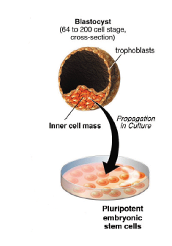
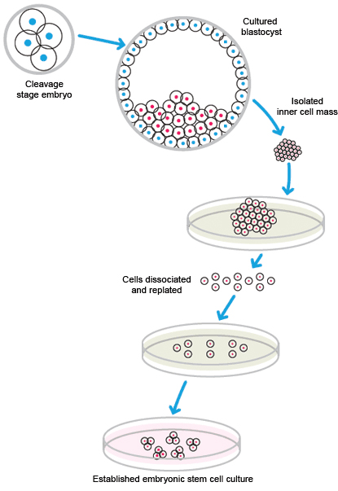

Slide 22
Isolation of adult stem cells
From the body
From amniotic fluid
From umbilical chord

Slide 23
From the body itself
Adult stem cells have been found in the brain, bone marrow, blood vessels, skeletal muscle, skin, teeth, heart, gut, liver, and other organs and tissues.
Adult stem cells can be isolated from the body in different ways, depending on the tissue. Blood stem cells, for example, can be taken from a donor’s bone marrow, from blood in the umbilical cord when a baby is born, or from a person’s circulating blood.
Mesenchymal stem cells, which can make bone, cartilage, fat, fibrous connective tissue.
Neural stem cells (which form the brain’s three major cell types) have been isolated from the brain and spinal cord.

Slide 24
From amniotic fluid
Amniotic fluid, which bathes the fetus in the womb, contains fetal cells including mesenchymal stem cells, which are able to make a variety of tissues.
Many pregnant women elect to have amniotic fluid drawn to test for chromosome defects, the procedure known as amniocentesis.

Slide 25
Cord Blood
Umbilical cord blood is also known as placental blood.
It is the blood that flows in the circulation of the developing fetus in the womb.
After the baby’s birth, the left over blood in the umbilical cord and placenta is called cord blood.
This blood is a rich source of stem cells.

Slide 26
Collecting cord blood stem cells
This blood is collected by the physician after the baby is born and the cord is cut.
It takes less than 5 minutes and there is no pain, harm or risk to mother or newborn.
This cord blood containing the stem cells, is sent to a “Cord Blood Bank” either private or public where it is processed and the stem cells are preserved in liquid nitrogen.

Slide 27
Umbilical cord stem cells
Adult stem cells of infant origin
Less expensive

Slide 28
Culturing of Stem cells
The culture conditions and types of media used for stem cell culture depend on the type of stem cell.
There are a wide range of protocols and products available for both maintaining stem cells in an undifferentiated state and for differentiating them into different lineages and cell types.

Slide 29
Cell Culture Techniques for ESC
Isolate & transfer of inner cell mass into plastic culture dish that contains culture medium
Cells divide and spread over the dish
Inner surface of culture dish is typically coated with mouse embryonic skin cells that have been treated so they will not divide.

Slide 30
This coating is called a FEEDER LAYER
Feeder cells provide ES cells with a sticky surface for attachment
Feeder cells release nutrients
Recent discovery: methods for growing embryonic stem cells without mouse feeder cells
Significance – eliminate infection by viruses or other mouse molecules
ES cells are removed gently and plated into several different culture plates before crowding occurs

Slide 31
Feeder Cell Layers
All the ESC cultures are maintained on feeder cell layers.
Inactivated mouse embryonic fibroblasts (MEFs) were used as feeder layers that provide factors and a substrate that allow ESCs to grow and divide.
There are several problems associated with MEFs, including the potential for the introduction of mouse-derived infectious agents, undesirable protein transfer.

Slide 32
Methodology
MEFs can either be purchased or freshly generated in the lab.
Fibroblasts from ~14–15-day-old fetal mice are cultured and expanded for 3–4 days.
To be used as a feeder layer, MEFs must be mitotically inactivated, either by irradiation with UV light or incubation with mitomycin C.
Stocks of MEF cells can be frozen either before or after inactivation.

Slide 34
Feeder-free culture
There are two types of feeder cell-free media: defined media and conditioned media.
These media will support the growth of stem cells and contain factors that inhibit differentiation.
The components of the media and the supplements vary depending on the type of stem cell.

Slide 35
Defined medium
Defined medium is a serum-free medium that has been supplemented with recombinant growth factors and other molecules that are required to support the growth and pluripotency of cells.
Media formulated for stem cell culture often contain factors such as leukemia inhibitory factor and bone morphogenetic protein to prevent differentiation.
Some defined media for human cell culture may contain bovine serum albumin (BSA).

Slide 36
Conditioned medium
Cells in culture secrete factors into the media that support cell growth.
After cells have grown and divided for a period of time, the media are removed.
This conditioned media can then be used as a supplement along with fresh media.
An advantage of conditioned media is that they contain more factors than defined media.
The disadvantage is that the contamination with virus.
Human skin fibroblasts are the most common cell type used to make conditioned media for human cells.

Slide 37
Stem cells not growing on a feeder layer need a matrix for attachment and growth.
A culture matrix contains extracellular matrix (ECM) proteins and polysaccharides such as vitronectin and proteoglycans.
There are many matrices available with varying combinations of proteins and carbohydrates.
Different types and sources of stems cells require different matrices, and different matrix components can either maintain pluripotency or help drive differentiation.

